Slide 1
UNIT -5 PROCESS CONTROL

Slide 2
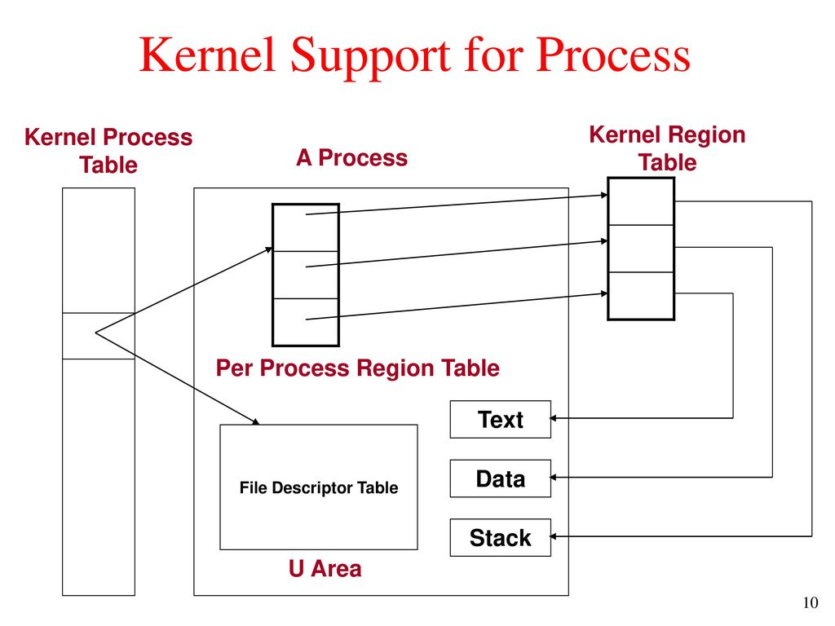

Slide 3
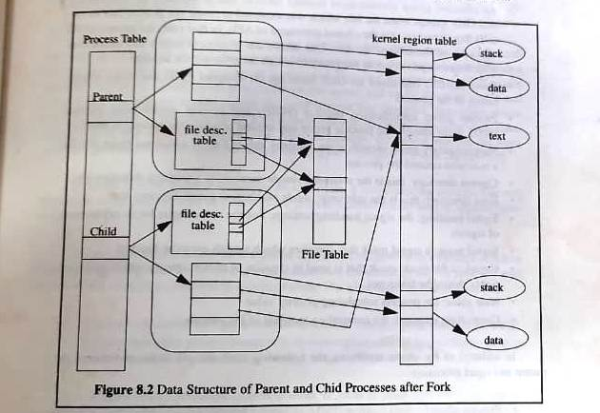

Slide 4
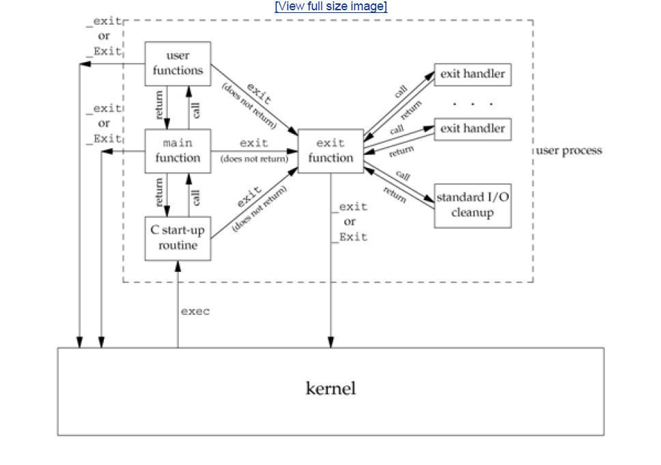
Lifetime of a UNIX Process and How a C program is started and how it terminates

Slide 5
Process Termination
There are 8 ways for a process to terminate.
Normal termination:
return from main
calling exit
calling exit (or Exit)
return of last thread from its start routine
calling pthread_exit from last thread
Abnormal termination:
calling abort
terminated by a signal
response of the last thread to a cancellation request

Slide 6
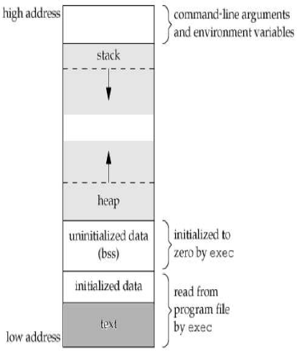
Memory Layout of a C Program

Slide 7
Memory Layout of a C Program contd..
Text segment, the machine instructions that the CPU executes. Usually, the text segment is sharable so that only a single copy needs to be in memory for frequently executed programs, such as text editors, the C compiler, the shells, and so on. Also, the text segment is often read-only, to prevent a program from accidentally modifying its instructions.
Initialized data segment, usually called simply the data segment, containing variables that are specifically initialized in the program. For example, the C declaration
int maxcount = 99;
appearing outside any function causes this variable to be stored in the initialized data segment with its initial value.
Uninitialized data segment, often called the "bss" segment, named after an ancient assembler operator that stood for "block started by symbol." Data in this segment is initialized by the kernel to arithmetic 0 or null pointers before the program starts executing. The C declaration
long sum[1000];
appearing outside any function causes this variable to be stored in the uninitialized data
segment.

Slide 8
Memory Layout of a C Program contd..
Stack: where automatic variables are stored, along with information that is saved each time a function is called. Each time a function is called, the address of where to return to and certain information about the caller's environment, such as some of the machine registers, are saved on the stack. The newly called function then allocates room on the stack for its automatic and temporary variables. This is how recursive functions in C can work. Each time a recursive function calls itself, a new stack frame is used, so one set of variables doesn't interfere with the variables from another instance of the function.
Heap: where dynamic memory allocation usually takes place. Historically, the heap has been located between the uninitialized data and the stack.

Slide 9
Process identifiers
Every process has a unique process ID, a
non negative integer
Special processes :
1) process ID 0 - scheduler process
scheduler process also known as swapper
2) process ID 1 init process
a. program file of init is present in /etc/init or /sbin/init
b. init is called after bootstrapping to bring up UNIX system
c. init process never dies ,it’s a normal user process run with super user privilege
3)process ID 2 pagedaemon
  For paging of VM system

Slide 10
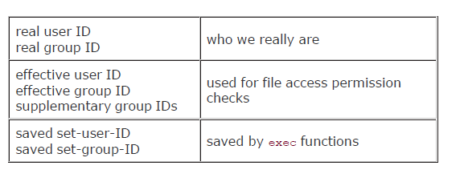
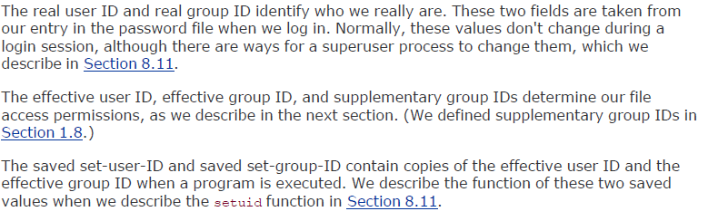
Process ID’s

Slide 11
#include <unistd.h> #include <sys/types.h> pid_t getpid (void); Returns: process ID of calling process pid_t getppid (void); Returns: parent process ID of calling process uid_t getuid (void); Returns: real user ID of calling process uid_t geteuid (void); Returns: effective user ID of calling process gid_t getgid (void); Returns: real group ID of calling process gid_t getegid (void); Returns: effective group ID of calling process

Slide 12
Fork function
UNIX kernel creates a new process when an existing process calls the fork function
#include <sys/types.h> #include <unistd.h> pid_t fork (void);

Slide 13
The new process created by fork is called child process
The function is called once but returns twice
The return value in the child is 0
The return value in parent is the process ID of the new child
The child is a copy of parent
Child gets a copy of parents text, data , heap and stack
Instead of completely copying we can use COW copy on write technique

Slide 14
#include <sys/types.h>
#include "ourhdr.h"
int glob = 6;
/* external variable in initialized data */
char buf[ ] = "a write to stdout\n";
int main(void)
{
int var;
/* automatic variable on the stack */
pid_t pid;

Slide 15
var = 88;
if (write(STDOUT_FILENO, buf, sizeof(buf)-1) != sizeof(buf)-1)
err_sys("write error");
printf("before fork\n");
if ( (pid = fork()) < 0)
err_sys("fork error");
else if (pid == 0)
{ /* child */
glob++; /* modify variables */
var++;
}

Slide 16
else
sleep(2);
/* parent */
printf("pid = %d, glob = %d, var = %d\n", getpid(), glob, var);
exit(0);
}

Slide 17
FILE SHARING
Fork creates a duplicate copy of the file descriptors opened by parent
There are two ways of handling descriptors after fork
The parent waits for the child to complete
After fork the parent closes all descriptors that it doesn’t need and child does the same

Slide 18
Besides open files the other properties inherited by child are
Real user ID, group ID, effective user ID, effective group ID
Supplementary group ID
Process group ID
Session ID
Controlling terminal
set-user-ID and set-group-ID
Current working directory

Slide 19
Root directory
File mode creation mask
Signal mask and dispositions
The close-on-exec flag for any open file descriptors
Environment
Attached shared memory segments
Resource limits

Slide 20
The difference between the parent and child
The return value of fork
The process ID
Parent process ID
The values of tms_utime , tms_stime , tms_cutime , tms_ustime is 0 for child
file locks set by parent are not inherited by child
Pending alrams are cleared for the child
The set of pending signals for the child is set to empty set

Slide 21
Why Fork fails
- too many processes are in the system
- if the total number of processes for this real user ID exceeds the system's limit (CHILD_MAX )
The Uses of fork
A process can duplicate itself so that parent and child can each execute different sections of code (needed in network client / server applications)
A process can execute a different program
(needed in shells )

Slide 22
vfork
It is same as fork
It is intended to create a new process when the purpose of new process is to exec a new program
The child runs in the same address space as parent until it calls either exec or exit
vfork guarantees that the child runs first ,
until the child calls exec or exit

Slide 23
int glob = 6;
/* external variable in initialized data */
int main(void)
{
int var;
/* automatic variable on the stack */
pid_t pid;
var = 88;
printf("before vfork\n");
if ( (pid = vfork()) < 0)
err_sys("vfork error");

Slide 24
else if (pid == 0) { /* child */
glob++;
/* modify parent's variables */
var++;
_exit(0); /* child terminates */
}
/* parent */
printf("pid = %d, glob = %d, var = %d\n", getpid(), glob, var);
exit(0);
}

Slide 25
exit functions
Normal termination
Return from main
Calling exit – includes calling exit handlers
Calling _exit – it is called by exit function
Abnormal termination
Calling abort – SIGABRT
When process receives certain signals

Slide 26
Exit status is used to notify parent how a
child terminated
When a parent terminates before the
child, the child is inherited by init process
If the child terminates before the parent
then the information about the is obtained
by parent when it executes wait or waitpid
The information consists of the process
ID, the termination status and amount of
CPU time taken by process

Slide 27
A process that has terminated , but
whose parents has not yet waited for
it, is called a zombie
When a process inherited by init
terminates it doesn’t become a zombie
Init executes one of the wait functions to
fetch the termination status

Slide 28
Wait and waitpid functions
When a child id terminated the parent is
notified by the kernel by sending a SIGCHLD signal
The termination of a child is an asynchronous event
The parent can ignore or can provide a function that is called when the signal occurs

Slide 29
The process that calls wait or waitpid can
Block
Return immediately with termination status of the child
Return immediately with an error
#include <sys/wait.h> #include <sys/types.h> pid_t wait (int *statloc); pid_t waitpid (pid_t pid,int *statloc , int options );

Slide 30
Statloc is a pointer to integer
If statloc is not a null pointer ,the termination status of the terminated process is stored in the location pointed to by the argument
The integer status returned by the two functions give information about exit status, signal number and about generation of core file

Slide 31
Macros which provide information about how a process terminated
WIFEXITED | TRUE – if child terminated normally WEXITSTATUS – is used to fetch the lower 8 bits of argument child passed to exit or _exit

Slide 32
WIFSIGNALED | TRUE – if child terminated abnormally WTERMSIG – is used to fetch the signal number that caused termination WCOREDUMP – is true is core file was generated
WIFSTOPPED | TRUE – for a child that is currently stopped WSTOPSIG -- is used to fetch the signal number that caused child to stop

Slide 33
waitpid
The interpretation of pid in waitpid depends on its value
Pid == -1 – waits for any child
Pid > 0 – waits for child whose process ID equals pid
Pid == 0 – waits for child whose process group ID equals that of calling process
Pid < -1 – waits for child whose process group ID equals to absolute value of pid

Slide 34
Waitpid helps us wait for a particular process
It is nonblocking version of wait
It supports job control
WNOHANG | Waitpid will not block if the child specified is not available
WUNTRACED | supports job control

Slide 35
void pr_exit(int status)
{
if (WIFEXITED(status))
printf("normal termination, exit status = %d\n",
WEXITSTATUS(status));
else if (WIFSIGNALED(status))
printf("abnormal termination, signal number = %d%s\n“, WTERMSIG(status),
#ifdef WCOREDUMP
WCOREDUMP(status) ? " (core file generated)" : "");
#else
"");
#endif
else if (WIFSTOPPED(status))
printf("child stopped, signal number = %d\n",
WSTOPSIG(status));
}

Slide 36
#include <sys/types.h>
#include <sys/wait.h>
#include "ourhdr.h"
Int main(void)
{
pid_t pid;
int status;
if ( (pid = fork()) < 0)
err_sys("fork error");
else if (pid == 0) /* child */
exit(7);

Slide 37
if (wait(&status) != pid)
/* wait for child */
err_sys("wait error");
pr_exit(status);
/* and print its status */
if ( (pid = fork()) < 0)
err_sys("fork error");
else if (pid == 0) /* child */
abort();
/* generates SIGABRT */

Slide 38
if (wait(&status) != pid)
/* wait for child */
err_sys("wait error");
pr_exit(status);
/* and print its status */
if ( (pid = fork()) < 0)
err_sys("fork error");
else if (pid == 0) /* child */
status /= 0;
/* divide by 0 generates SIGFPE */

Slide 39
if (wait(&status) != pid)
/* wait for child */
err_sys("wait error");
pr_exit(status);
/* and print its status */
exit(0);
}

Slide 40
output
$ ./a.out
normal termination, exit status = 7
abnormal termination, signal number = 6 (core file generated)
abnormal termination, signal number = 8 (core file generated)

Slide 41
Differences between wait & wait pid
The wait function can block the caller until a child process terminates, whereas waitpid has an option that prevents it from blocking.
The waitpid function doesn't wait for the child that terminates first; it has a number of options that control which process it waits for

Slide 42
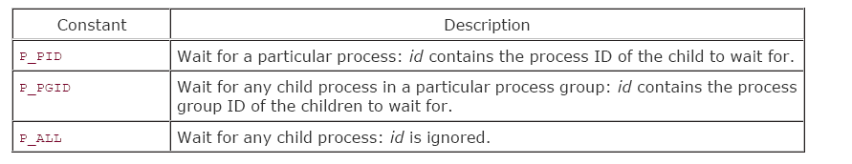
waitid Function
an additional function to retrieve the exit status of a process
#include <sys/wait.h>
int waitid(idtype_t idtype, id_t id, siginfo_t *infop, int options);
Returns: 0 if OK, 1 on error
Values of idtype
The infop argument is a pointer to a siginfo structure that contains details of signal generated.

Slide 43
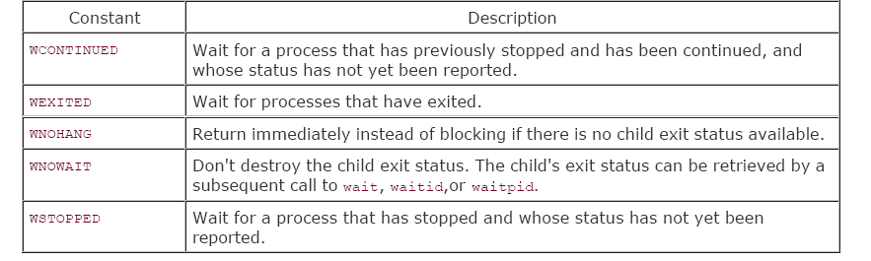
waitid Function contd…

Slide 44
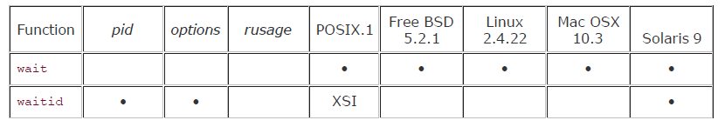
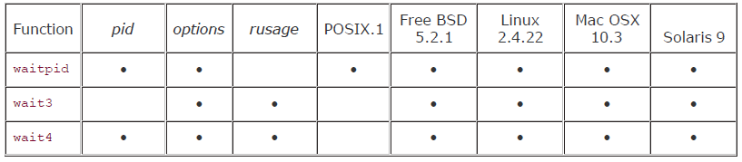
wait3 and wait4 functions
These functions are same as waitpid but provide additional information about the resources used by the terminated process

Slide 45
#include <sys/wait.h> #include <sys/types.h> #include <sys/times.h> #include <sys/resource.h> pid_t wait3 (int *statloc ,int options, struct rusage *rusage ); pid_t wait4 (pid_t pid ,int *statloc ,int options, struct rusage *rusage );

Slide 46
Race condition
Race condition occurs when multiple process are trying to do something with shared data and final out come depends on the order in which the processes run

Slide 47
Program with race condition
#include <sys/types.h>
static void charatatime(char *);
int main(void)
{
pid_t pid;
if ( (pid = fork()) < 0)
err_sys("fork error");

Slide 48
else if (pid == 0)
{
charatatime("output from child\n");
}
else
{
charatatime("output from parent\n");
}
exit(0);
}

Slide 49
static void
charatatime(char *str)
{
char *ptr;
int c;
setbuf(stdout, NULL);
/* set unbuffered */
for (ptr = str; c = *ptr++; )
putc(c, stdout);
}

Slide 50
/*altered program*/
#include <sys/types.h>
#include "ourhdr.h"
static void charatatime(char *);
Int main(void)
{
pid_t pid;
TELL_WAIT();
if ( (pid = fork()) < 0)
err_sys("fork error");

Slide 51
else if (pid == 0)
{
WAIT_PARENT(); /* parent goes first */
charatatime("output from child\n");
}
else {
charatatime("output from parent\n");
TELL_CHILD(pid);
}
exit(0);
}

Slide 52
static void charatatime(char *str)
{
char *ptr;
int c;
setbuf(stdout, NULL);
/* set unbuffered */
for (ptr = str; c = *ptr++; )
putc(c, stdout);
}

Slide 53
exec functions
Exec replaces the calling process by a new program
The new program has same process ID as the calling process
No new program is created , exec just replaces the current process by a new program

Slide 54
#include <unistd.h> int execl( const char *pathname, const char *arg0 ,… /*(char *) 0*/); int execv (const char *pathname, char * const argv[ ]); int execle (const char *pathname, const char *arg0 ,… /*(char *) 0, char *const envp[ ] */);

Slide 55
int execve ( const char *pathname, char *const argv[ ] , char *const envp [ ]); int execlp (const char *filename, const char *arg0 ,… /*(char *) 0*/); int execvp (const char *filename ,char *const argv[ ] );

Slide 56
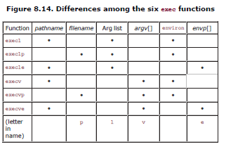

Slide 57
Relation between exec functions
execl
execle
execlp
Build argv
Build argv
Build argv
Try each
use
execvp
execv
execve
PATH prefix
environ

Slide 58
#include <sys/types.h>
#include <sys/wait.h>
#include "ourhdr.h"
char *env_init[ ] =
{ "USER=unknown", "PATH=/tmp", NULL };
int main(void)
{
pid_t pid;
if ( (pid = fork()) < 0)
err_sys("fork error");
else if (pid == 0) {
/* specify pathname, specify environment */

Slide 59
if ( execle ("/home/stevens/bin/echoall",
"echoall", "myarg1", "MY ARG2",
(char *) 0, env_init) < 0)
err_sys("execle error");
}
if (waitpid(pid, NULL, 0) < 0)
err_sys("wait error");
if ( (pid = fork()) < 0)
err_sys("fork error");

Slide 60
else if (pid == 0) {
/* specify filename, inherit environment */
if (execlp("echoall",
"echoall", "only 1 arg",
(char *) 0) < 0)
err_sys("execlp error");
}
exit(0);
}

Slide 61
Changing user IDs and group IDs
Prototype
#include <sys/types.h> #include <unistd.h> int setuid (uid_t uid); int setgid (gid_t gid);

Slide 62
Rules
If the process has superuser privilege, the setuid function sets – real user ID, effective user ID , saved set-user-ID to uid
If the process doesnot have superuser privilege, but uid equals either real user ID or saved set-user-ID, setuid sets only effective user ID to uid
If neither of the two conditions is true, errno is set to EPERM and an error is returned

Slide 63
ID | exec Set-user-ID bit off | exec Set-user-Id bit on
Real user ID Effective user ID Saved set user ID | unchanged unchanged copied from effective user ID | unchanged Set from user ID of program file copied from effective user ID

Slide 64
ID |  | Super user | Un privileged user
Real user ID Effective user ID Saved set-user ID |  | Set to uid Set to uid Set to uid | unchanged Set to uid unchanged

Slide 65
setreuid and setregid
#include <sys/types.h> #include <unistd.h> int setreuid (uid_t ruid, uid_t euid); int setregid (gid_t rgid,gid_t egid);

Slide 66
seteuid and setegid
#include <sys/types.h> #include <unistd.h> int seteuid (uid_t euid); int setegid (gid_t egid);

Slide 67
Superuser
setreuid
Superuser
setuid
Superuser
seteuid
euid
uid
uid
uid
uid
Effective
User ID
Saved
Set-user-ID
Real user ID
Unprivileged
setreuid
Unprivileged
setreuid
Exec of
set-user-id
Unprivileged
Setuid or seteuid
Unprivileged
Setuid or seteuid

Slide 68
Interpreter files
Files which begin with a line of the form
#! pathname [ optional argument ]
most common example :
#! /bin/bash
The actual file execed by kernel is the one specified in the pathname

Slide 69
/*example of interpreter file*/
#!/bin/awk -f
BEGIN
{
for (i = 0; i < ARGC; i++)
printf "ARGV[%d] = %s\n", i, ARGV[i]
exit
}

Slide 70
Uses of interpreter files
They hide the fact that certain programs are scripts in some other language
They provide an efficiency gain
but more work is needed that is e
execlp(with filename) -> no m/c executable -> then call /bin/csh -> call fork,exec & wait
They help us write shell scripts using shells other than /bin/sh

Slide 71
system function
It helps us execute a command string within a program
System is implemented by calling fork, exec and waidpid
#include <stdlib.h> int system (const char *cmdstring);

Slide 72
Return values of system function
-1 – if either fork fails or waitpid returns an error other than EINTR
127 -- If exec fails [as if shell has executed exit ]
termination status of shell -- if all three functions succeed

Slide 73
#inclde <sys/types.h>
#include <sys/wait.h>
#include <errno.h>
#include <unistd.h>
int system(const char *cmdstring)
/* version without signal handling */
{
pid_t pid;
int status;

Slide 74
if (cmdstring == NULL)
return(1);
/* always a command processor with Unix */
if ( (pid = fork()) < 0)
{
status = -1;
/* probably out of processes */
} else if (pid == 0)
{ /* child */
execl("/bin/sh", "sh", "-c", cmdstring,
(char *) 0);
_exit(127); /* execl error */
}

Slide 75
else { /* parent */
while (waitpid(pid, &status, 0) < 0)
if (errno != EINTR) {
status = -1;
/* error other than EINTR from waitpid() */
break;
}
}
return(status);
}

Slide 76
/* calling system function*/
#include <sys/types.h>
#include <sys/wait.h>
#include "ourhdr.h"
int main(void)
{
int status;
if ( (status = system("date")) < 0)
err_sys("system() error");
pr_exit(status);

Slide 77
if ( (status = system("nosuchcommand")) < 0)
err_sys("system() error");
pr_exit(status);
if ( (status = system("who; exit 44")) < 0)
err_sys("system() error");
pr_exit(status);
exit(0);
}

Slide 78
output
[umesh@localhost THEORY PRGMS]$ g++ syst.c
[umesh@localhost THEORY PRGMS]$ ./a.out
Tue Feb 26 19:41:44 IST 2013
normal termination, exit status = 0
sh: nosuchcommand: command not found
normal termination, exit status = 127
umesh tty1 2013-02-26 18:23 (:0)
umesh pts/0 2013-02-26 18:46 (:0.0)
normal termination, exit status = 44
[umesh@localhost THEORY PRGMS]$ who
umesh tty1 2013-02-26 18:23 (:0)
umesh pts/0 2013-02-26 18:46 (:0.0)

Slide 79
example-2 on system
Int main(int argc, char *argv[])
{
int
status;
if (argc < 2)
err_quit("command-line argument required");
if ((status = system(argv[1])) < 0)
err_sys("system() error");
pr_exit(status);
exit(0);
}

Slide 80
Process accounting
Process accounting : when enabled kernel writes an accounting record each time a process terminates
Accounting records : 32 bytes of binary data

Slide 81
typedef u_short comp_t; /* 3-bit base 8 exponent; 13-bit fraction */
struct acct
{
char ac_flag; /* flag (see Figure 8.26) */
char ac_stat; /* termination status (signal & core flag only) */
/* (Solaris only) */
uid_t ac_uid; /* real user ID */
gid_t ac_gid; /* real group ID */
dev_t ac_tty; /* controlling terminal */
time_t ac_btime; /* starting calendar time */
comp_t ac_utime; /* user CPU time (clock ticks) */
comp_t ac_stime; /* system CPU time (clock ticks) */
comp_t ac_etime; /* elapsed time (clock ticks) */
comp_t ac_mem; /* average memory usage */
comp_t ac_io; /* bytes transferred (by read and write) */
/* "blocks" on BSD systems */
comp_t ac_rw; /* blocks read or written */
/* (not present on BSD systems) */
char ac_comm[8]; /* command name: [8] for Solaris, */
/* [10] for Mac OS X, [16] for FreeBSD, and */
/* [17] for Linux */
};

Slide 82
/*prog: to generate accounting data */
#include <sys/types.h>
#include <sys/acct.h>
#include "ourhdr.h"
#define ACCTFILE "/var/adm/pacct"
static unsigned long compt2ulong(comp_t);
int main(void)
{
struct acct acdata;
FILE *fp;

Slide 83
if ( (fp = fopen(ACCTFILE, "r")) == NULL)
err_sys("can't open %s", ACCTFILE);
while
(fread(&acdata, sizeof(acdata), 1, fp) == 1)
{ printf("%-*.*s e = %6ld, chars = %7ld, "
"stat = %3u: %c %c %c %c\n",
sizeof(acdata.ac_comm),
sizeof(acdata.ac_comm),
acdata.ac_comm,
compt2ulong(acdata.ac_etime),
compt2ulong(acdata.ac_io),
(unsigned char) acdata.ac_stat,

Slide 84
#ifdef ACORE
/* SVR4 doesn't define ACORE */
acdata.ac_flag & ACORE ? 'D' : ' ',
#else
' ',
#endif
#ifdef AXSIG
/* SVR4 doesn't define AXSIG */
acdata.ac_flag & AXSIG ? 'X' : ' ',
#else
' ',
#endif

Slide 85
acdata.ac_flag & AFORK ? 'F' : ' ',
acdata.ac_flag & ASU ? 'S' : ' ');
}
if (ferror(fp))
err_sys("read error");
exit(0);
}

Slide 86
static unsigned long
compt2ulong(comp_t comptime)
/* convert comp_t to unsigned long */
{
unsigned long val;
int exp;
val = comptime & 017777;
/* 13-bit fraction */
exp = (comptime >> 13) & 7;
/* 3-bit exponent (0-7) */
while (exp-- > 0)
val *= 8;
return(val);
}

Slide 87
User identification
To obtain the login name
#include <unistd.h> char *getlogin (void);

Slide 88
Process times
Struct tms {
clock_t tms_utime;
clock_t tms_stime;
clock_t tms_cutime;
clock_t tms_cstime;
}
#include <sys/times.h> clock_t times (struct tms *buf);

Slide 89
#include <sys/times.h>
#include "ourhdr.h"
static void
pr_times (clock_t, struct tms *, struct tms *);
static void do_cmd(char *);
int main (int argc, char *argv[ ])
{ int i;
for (i = 1; i < argc; i++)
do_cmd(argv[i]);
/* once for each command-line arg */
exit(0);
}

Slide 90
static void
do_cmd (char *cmd)
/* execute and time the "cmd" */
{
struct tms tmsstart, tmsend;
clock_t start, end;
int status;
fprintf(stderr, "\ncommand: %s\n", cmd);
if ( (start = times(&tmsstart)) == -1)
/* starting values */
err_sys("times error");

Slide 91
if ( (status = system(cmd)) < 0)
/* execute command */
err_sys("system() error");
if ( (end = times(&tmsend)) == -1)
/* ending values */
err_sys("times error");
pr_times(end-start, &tmsstart, &tmsend);
pr_exit(status);
}

Slide 92
static void
pr_times (clock_t real, struct tms *tmsstart,
struct tms *tmsend)
{ static long clktck = 0;
if (clktck == 0)
/* fetch clock ticks per second first time */
if ( (clktck = sysconf(_SC_CLK_TCK)) < 0)
err_sys("sysconf error");
fprintf (stderr, " real: %7.2f\n", real / (double) clktck);

Slide 93
fprintf (stderr, " user: %7.2f\n",
(tmsend->tms_utime - tmsstart> tms_utime) / (double) clktck);
fprintf(stderr, " sys: %7.2f\n",
(tmsend->tms_stime - tmsstart->tms_stime) / (double) clktck);

Slide 94
fprintf(stderr, " child user: %7.2f\n",
(tmsend->tms_cutime - tmsstart-> tms_cutime) / (double) clktck);
fprintf (stderr, " child sys: %7.2f\n", (tmsend->tms_cstime - tmsstart-> tms_cstime) / (double) clktck);
}

Slide 95
Terminal logins
4.3+BSD terminal login
Process ID 1
init
Forks once per terminal
fork
init
Each child execs
getty
exec
init

Slide 96
init
Reads /etc/ttys
Forks once per terminal
creats empty environment
fork
init
exec
getty
opens terminal device
reads user name
exec
login

Slide 97
process ID 1
init
through login and getty
login shell
fd 0,1,2
terminal device
driver
RS – 232 connection
user at
a terminal

Slide 98
network login
proces ID 1
init
fork/exec of/bin/sh
which executes shell script /etc/rc
inetd
when connection request arives
from telnet user
fork
inetd
exec
telnetd

Slide 99
process ID 1
init
through inetd, telenetd
and login
login shell
fd 0, 1, 2
pseudo-terminal
device driver
network connection through
telnetd server and telnetd client
user at a
terminal

Slide 100
Process groups
A process group is a collection of one or more processes.
Each process group has a unique process group ID.
Process group IDs are similar to process IDs---they are positive integers and they can be stored in a pid_t data type.
The function getpgrp returns the process group ID of the calling process.

Slide 101
Each process group can have a process
leader. The leader is identified by having
its process group ID equal its process ID.
#include <sys/types.h> #include <unistd.h> pid_t getpgrp (void);

Slide 102
It is possible for a process group leader to create a process group, create processes in the group, and then terminate.
The process group still exists, as long as there is at least one process in the group, regardless whether the group leader terminates or not
process group lifetime — the period of time that begins when the group is created and ends when the last process in the group leaves the group

Slide 103
A process joins an existing process group, or creates a new process group by calling setpgid.
This sets the process group ID to pgid of the process pid. If the two arguments are equal, the process specified by pid becomes a process group leader.
#include <sys/types.h> #include <unistd.h> int setpgid (pid_t pid, pid_t pgid);

Slide 104
A process can set the process group ID of only itself or one of its children. If pid is 0, the process ID of the caller is used. Also if pgid is 0, the process ID specified by pid is used as the process group ID.
In most job-control shells this function is called after a fork to have the parent set the process group ID of the child, and to have the child set its own process group ID.

Slide 105
SESSIONS
A Session is a collection of one or more groups.
The processes in a process group are usually grouped together into a process group by a shell pipeline.
A process establishes a new session by calling the setsid function.
#include <sys/types.h> #include <unistd.h> pid_t setsid (void)

Slide 106
Login shell
proc1
proc2
proc3
proc4
Process group
Process group
proc5
process group
session
Arrangement of processes into
process groups and sessions

Slide 107
If the calling process is not a process group leader, this function creates a new session. Three things happen:
The process becomes the session leader of this new session.
The process becomes the process group leader of a new process group. The new process group ID is the process ID of the calling process.
The process has no controlling terminal.

Slide 108
Controlling terminal
characteristics of sessions and process groups
A session can have a single controlling terminal.
The session leader that establishes the connection to the controlling terminal is called the controlling process.
The process groups within a session can be divided into a single foreground process group and one or more background process groups.

Slide 109
If a session has a controlling terminal, then it has a single foreground process group, and all other process groups in the session are background process groups.
Whenever we type our terminal’s interrupt key or quit key this causes either the interrupt signal or the quit signal to be sent to all processes in the foreground process group.
If a modem disconnect is detected by the terminal interface, the hang-up signal is sent to the controlling process

Slide 110
session
Login shell
proc1
proc2
proc3
proc4
background process group
Session leader =
Controlling process
background process group
proc5
foreground process group
(hangup signal)
modem disconnect
Terminal input and
Terminal-generated signals
Controlling terminal
Process groups and sessions showing controlling terminal

Slide 111
tcgetpgrp and tcsetpgrp Functions
We need to tell the kernel which process group is the foreground process group, so that the terminal device driver knows where to send the terminal input and the terminal- generated signals
#include <sys/types.h> #include<unistd.h> pid_t tcgetpgrp(int filedes); int tcsetpgrp(int filedes, pid_t pgrpid);

Slide 112
The function tcgetpgrp returns the process group ID of the foreground process group associated with the terminal open on filedes.
If the process has a controlling terminal, the process can call tcsetpgrp to set the foreground process group ID to pgrpid..

Slide 113
Job Control
Why do we need job control?
To allow us to start multiple jobs from a single terminal and control which jobs can access the terminal and which jobs are to be run in the background.
It requires 3 forms of support:
A shell that supports job control.
The terminal driver in the kernel must support job control.
Support for certain job-control signals

Slide 114
A job is just a collection of processes, often a pipeline of processes.
When we start a background job, the shell assigns it a job identifier and prints one or more process IDs.
$ make all > Make.out &
[1] 1475
$ pr *.c | lpr &
[2] 1490
$ just press RETURN
[2] + Done pr *.c | lpr &
[1] + Done make all > Make.out &

Slide 115
The reason why we have to press RETURN is to have the shell print its prompt. The shell doesn’t print the changed status of background jobs at any random time -- only right before it prints its prompt, to let us enter a new command line.
Entering the suspend key (Ctrl + Z) causes the terminal driver to send the SIGTSTP signal to all processes in the foreground process group.

Slide 116
The terminal driver really looks for 3 special characters, which generate signals to the foreground process group:
The interrupt character generates SIGINT
The quit character generates SIGQUIT
The suspend character generates SIGTSTP

Slide 117
PROGRAM:
$cat temp.foo & start in background, but It’ll read from standard input
[1] 1681
$ we press RETURN
[1] + Stopped (tty input) cat > temp.foo &
$ fg %1 bring job number 1 to foreground
cat > temp.foo the shell tells us which job is now in the foreground
hello, world enter one line
^D type our end-of-file
$ cat temp.foo check that the one line put into the file
hello, world

Slide 118
What happens if a background job outputs to the controlling terminal?
This option we can allow or disallow. Normally we use the stty(1) command to change this option.
$ cat temp.foo & execute in background
[1] 1719
$ hello, world the output from the background appears after the prompt we press return
[1] + Done cat temp.foo &
$ stty tostop disable ability of background jobs to output to controlling terminal
[1] 1721
$ we press return and find the job is stopped
[1] + Stopped(tty output) cat temp.foo &

Slide 119
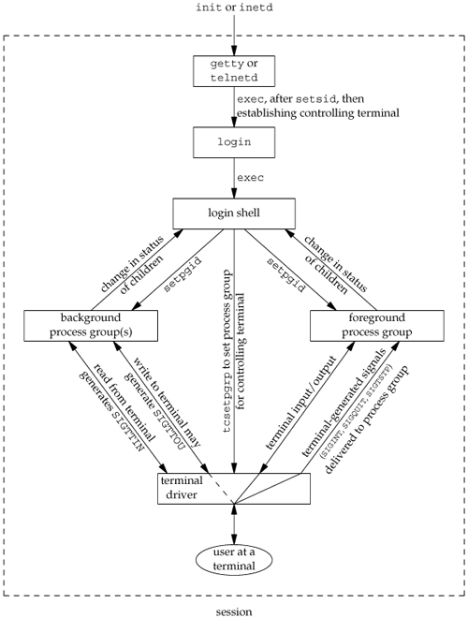
Summary of job control features with foreground and background jobs, and terminal driver

Slide 120
Shell Execution Of Programs
Bourne shell doesn’t support job control
ps –xj gives the following output
PPID PID PGID SID TPGID COMMAND
1 163 163 163 163 -sh
163 168 163 163 163 ps

Slide 121
Both the shell and the ps command are in the same session and foreground process group(163). The parent of the ps command is the shell.
A process doesn’t have a terminal process control group.
A process belongs to a process group, and the process group belongs to a session. The session may or may not have a controlling terminal.

Slide 122
The foreground process group ID is an
attribute of the terminal, not the process.
If ps finds that the session does not have
a controlling terminal, it prints -1.
If we execute the command in the background,
Ps –xj &
The only value that changes is the process ID.

Slide 123
ps –xj | cat1
PPID PID PGID SID TPGID COMMAND
1 163 163 163 163 -sh
163 200 163 163 163 cat1
200 201 163 163 163 ps
The last process in the pipeline is the child of the shell, and the first process in the pipeline is a child of the last process.

Slide 124
If we execute the pipeline in the background
ps –xj | cat1 &
Only the process IDs change.
Since the shell doesn’t handle job control, the process group ID of the background processes remains 163, as does the terminal process group ID.

Slide 125
Orphaned process groups
We know that a process whose parent terminates is called an orphan and is inherited by the init process.
Sometimes the entire process groups can be orphaned.

Slide 126
Process group 442
Login shell(PID 442)
Fork/exec
session
Parent( PID 512)
fork
Child(PID 513)
Process group 512

Slide 127
This is a job-control shell. The shell places the foreground process in its own process group( 512 in the example) and the shell stays in its own process group(442). The child inherits the process group of its parent(512). After the fork,
The parent sleeps for 5 seconds. This is the (imperfect) way of letting the child execute before the parent terminates
The child establishes a signal handler for the hang-up signal (SIGHUP). This is so we can see if SIGHUP is sent to the child.

Slide 128
The child itself the stop signal(SIGTSTP) with the kill function.
When the parent terminates, the child is orphaned, so the child’s parent process ID becomes 1, the init process ID.
At this point the child is now a member of an orphaned process group.

Slide 129
Since the process group is orphaned when the parent terminates, it is required that every process in the newly orphaned process group that is stopped be sent the hang-up signal (SIGHUP) followed by the continue signal.
This causes the child to be continued, after processing the hang-up signal. The default action for the hang-up signal is to terminate the process, which is why we have to provide a signal handler to catch the signal

Slide 130
Creating an orphaned process group
#include <sys/types.h>
#include <errno.h>
#include <fcntl.h>
#include <signal.h>
#include "ourhdr.h"
static void sig_hup(int);
static void pr_ids(char *);

Slide 131
int main(void)
{
char c;
pid_t pid;
pr_ids("parent");
if ( (pid = fork()) < 0)
err_sys("fork error");
else if (pid > 0)
{ /* parent */
sleep(5);
exit(0);
}

Slide 132
else { /* child */
pr_ids("child");
signal(SIGHUP, sig_hup);
/* establish signal handler */
kill (getpid(), SIGTSTP); pr_ids("child");
/* this prints only if we're continued */
if (read(0, &c, 1) != 1)
printf ("read error from control
terminal,errno = %d\n", errno); exit(0);
}
}

Slide 133
static void sig_hup (int signo)
{
printf("SIGHUP received, pid = %d\n",
getpid());
return;
}
static void pr_ids (char *name)
{
printf("%s: pid = %d, ppid = %d, pgrp =
d\n", name, getpid(), getppid(), getpgrp());
fflush(stdout);
}

Slide 134
/* OUTPUT
$ a.out
Parent: pid = 512, ppid=442, pgrp = 512
Child: parent = 513, ppid = 512, pgrp = 512
$ SIGHUP received, pid = 513
Child: pid = 513 , ppid = 1, pgrp = 512
Read error from control terminal, errno = 5
*/

Slide 135
The parent process ID of the child has become 1.
After calling pr_ids in the child, the program tries to read from standard input. When the background process group tries to read from its controlling terminal, SIGTTIN is generated from the background process group.
The child becomes the background process group when the parent terminates, since the parent was executed as a foreground job by the shell

Slide 136
The parent process ID of the child has become 1.
After calling pr_ids in the child, the program tries to read from standard input. When the background process group tries to read from its controlling terminal, SIGTTIN is generated from the background process group.
The child becomes the background process group when the parent terminates, since the parent was executed as a foreground job by the shell

Slide 137
Questions
Explain briefly the memory layout of a C program (10)
What is fork and vfork ? Explain with an example for each (8)
What is a zombie process ? Write a program in C/C++ to avoid zombie process by forking twice (6)
What is job control ? Summarize the job control features with the help of a figure (10)

Slide 138
Explain the different exec functions. Explain how their functioning differ from each other . Write a program that execs an interpreter file (10)
What is job control ? What support is required for job control ? Explain with an example (10)
Explain how accounting is done in UNIX system. Write a program to generate accounting data and give its process structure (10)

Slide 139
What is a controlling terminal ? Explain its characteristics and relation to session and process groups (10)
With an example explain the use of setjmp and longjmp functions (10)
What is race condition ? Write a program to demonstrate the race condition (10)
With a neat block diagram, explain how a C program is started and the various ways it can terminate. Give the prototypes for exit and _exit functions and explain their difference (10)

